Slide 1
Build an IoT Platform from Scratch
Project 7
Presenter : Soyeon Lee
Yuting Tan, Jayoung Hong, Donghyeon Lee, Eunjong Kim, Kamila Makhmudova

Slide 2
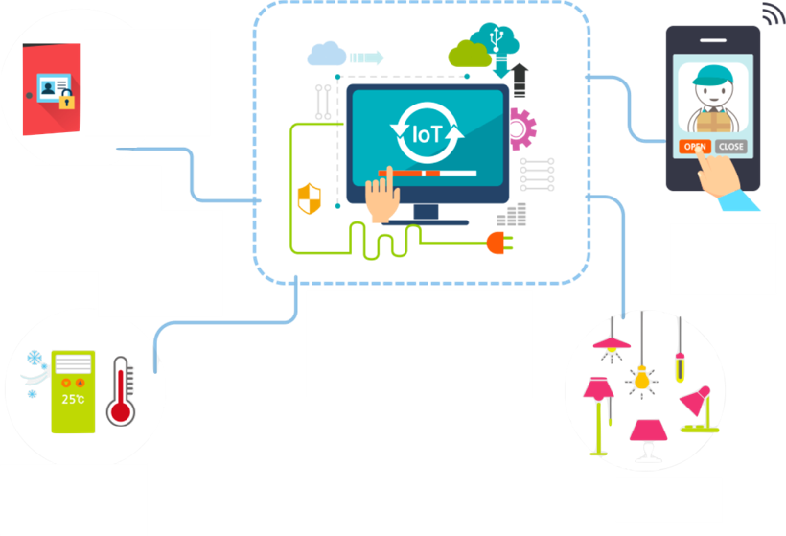

Build an IoT Platform from Scratch
Plan of project
Smart Home
Security camera
Control with application
Check temperature and humidity
Light system

Slide 3

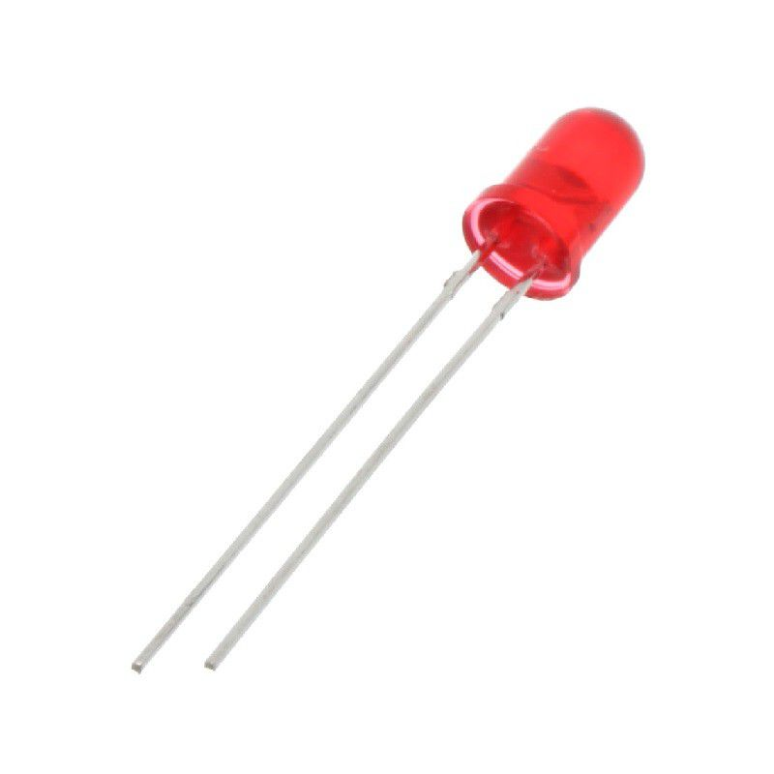



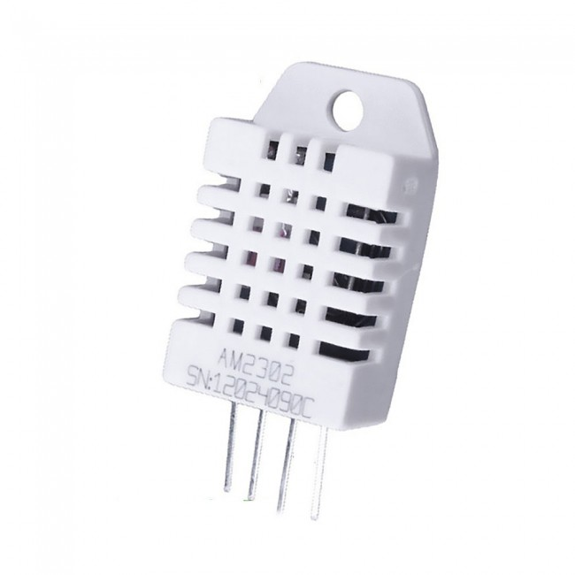

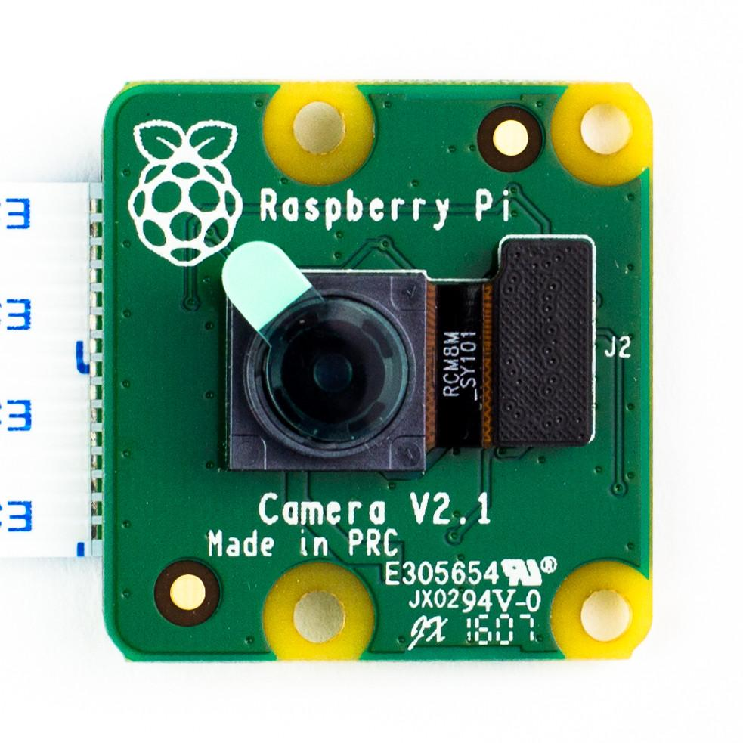

Build an IoT Platform from Scratch
Plan of project
LED
Thermo-hygrometer
PiCamera

Slide 4
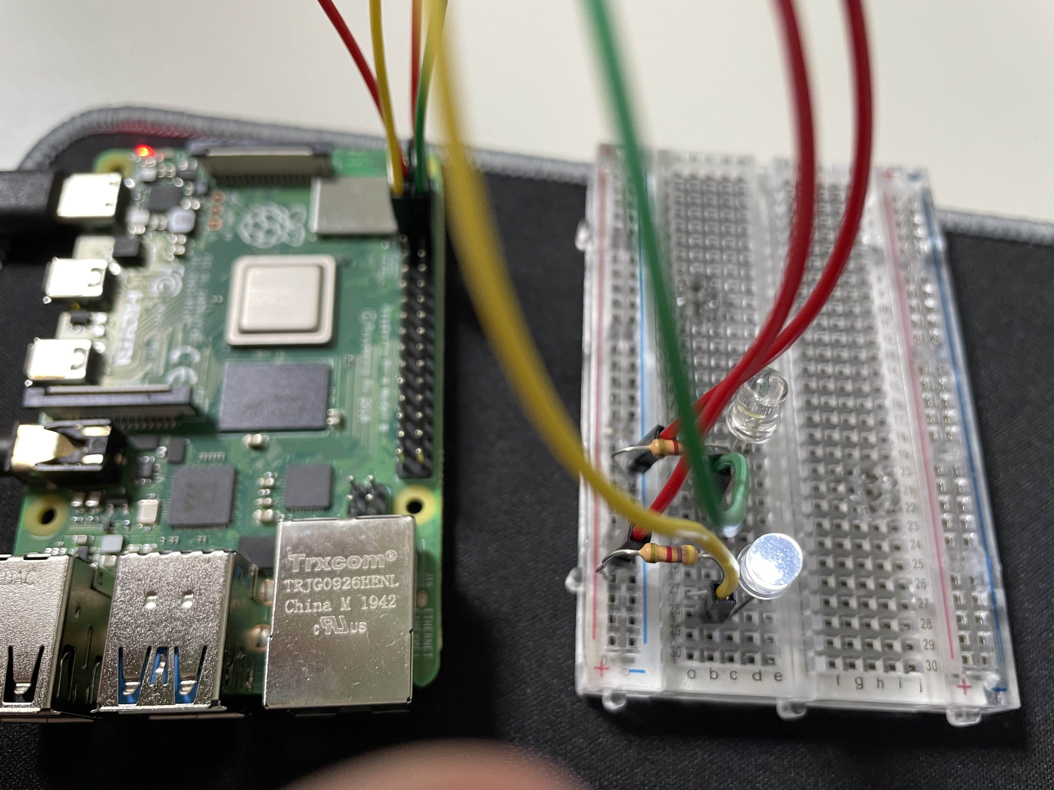
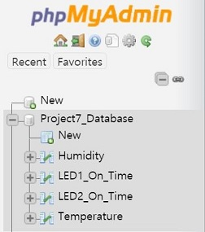
Build an IoT Platform from Scratch
Devices and database
LEDs connected to Raspberry pi
Database

Slide 5
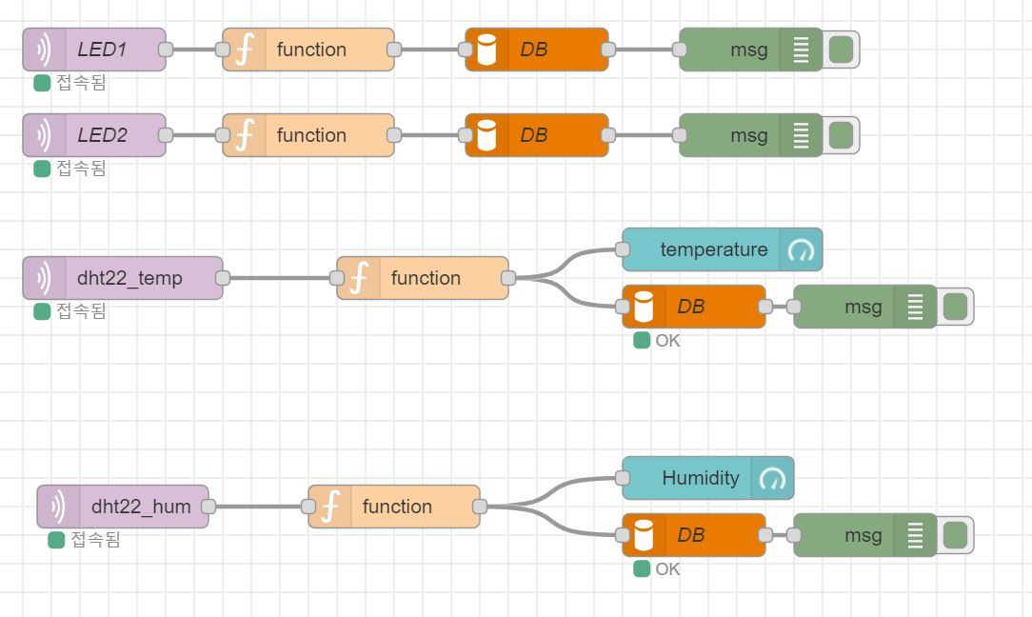
Build an IoT Platform from Scratch
Devices and database
Node-RED Flow
Function node

Slide 6
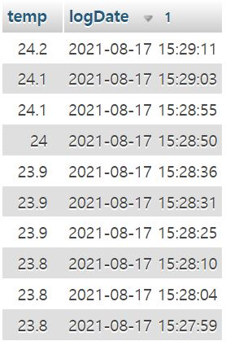
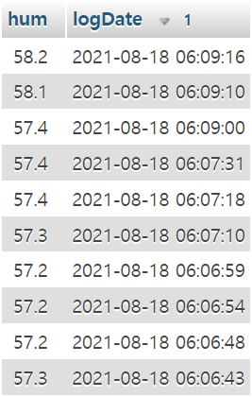
Build an IoT Platform from Scratch
Devices and database
Data stored in database

Slide 7
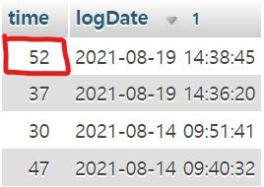
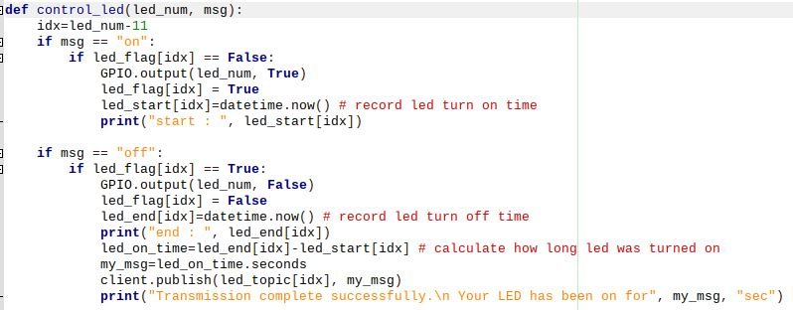
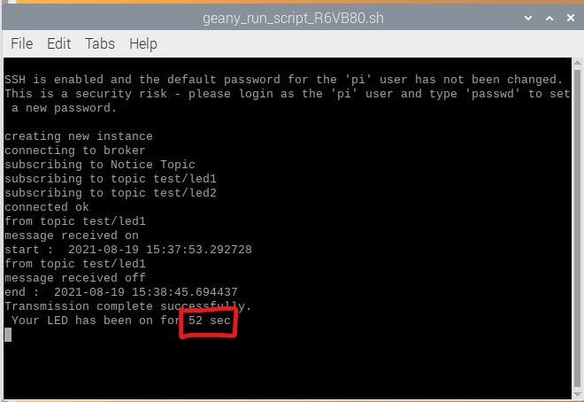
Build an IoT Platform from Scratch
Devices and database
Function code in Raspberry Pi
Database
Data transmission

Slide 8
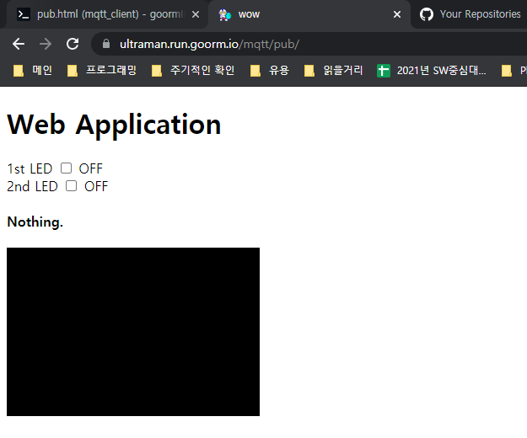
Build an IoT Platform from Scratch
Web application

Slide 9
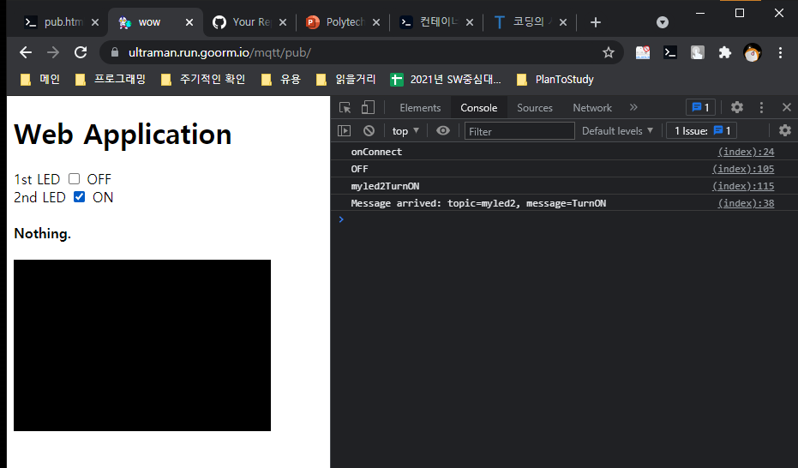
Build an IoT Platform from Scratch
Web application

Slide 10
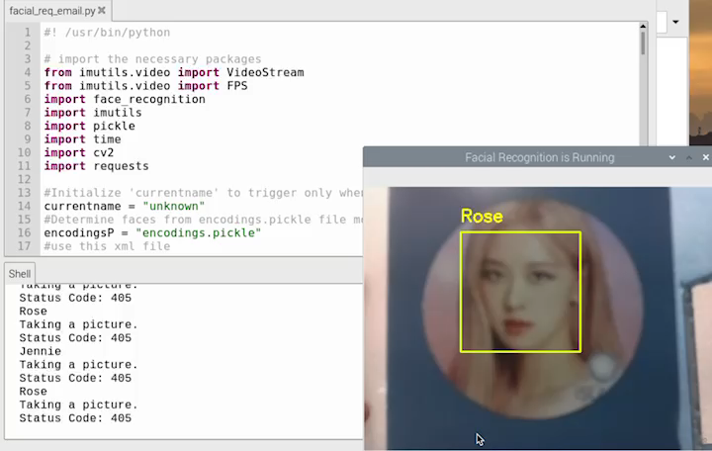
Build an IoT Platform from Scratch
Face Recognition

Slide 11
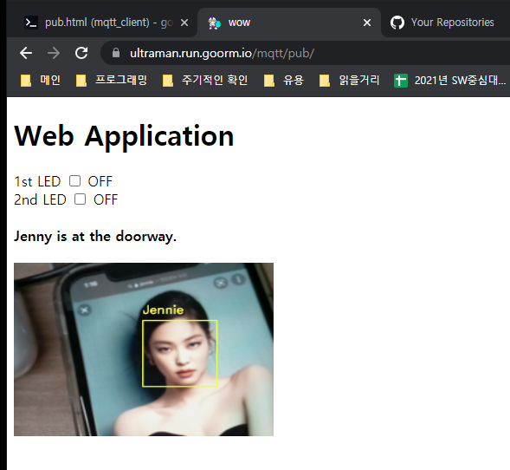
Build an IoT Platform from Scratch
Web application

Slide 12
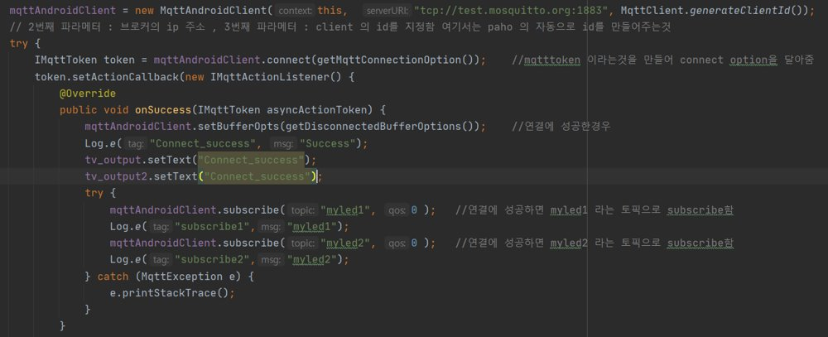
Build an IoT Platform from Scratch
Android application - MQTT

Slide 13
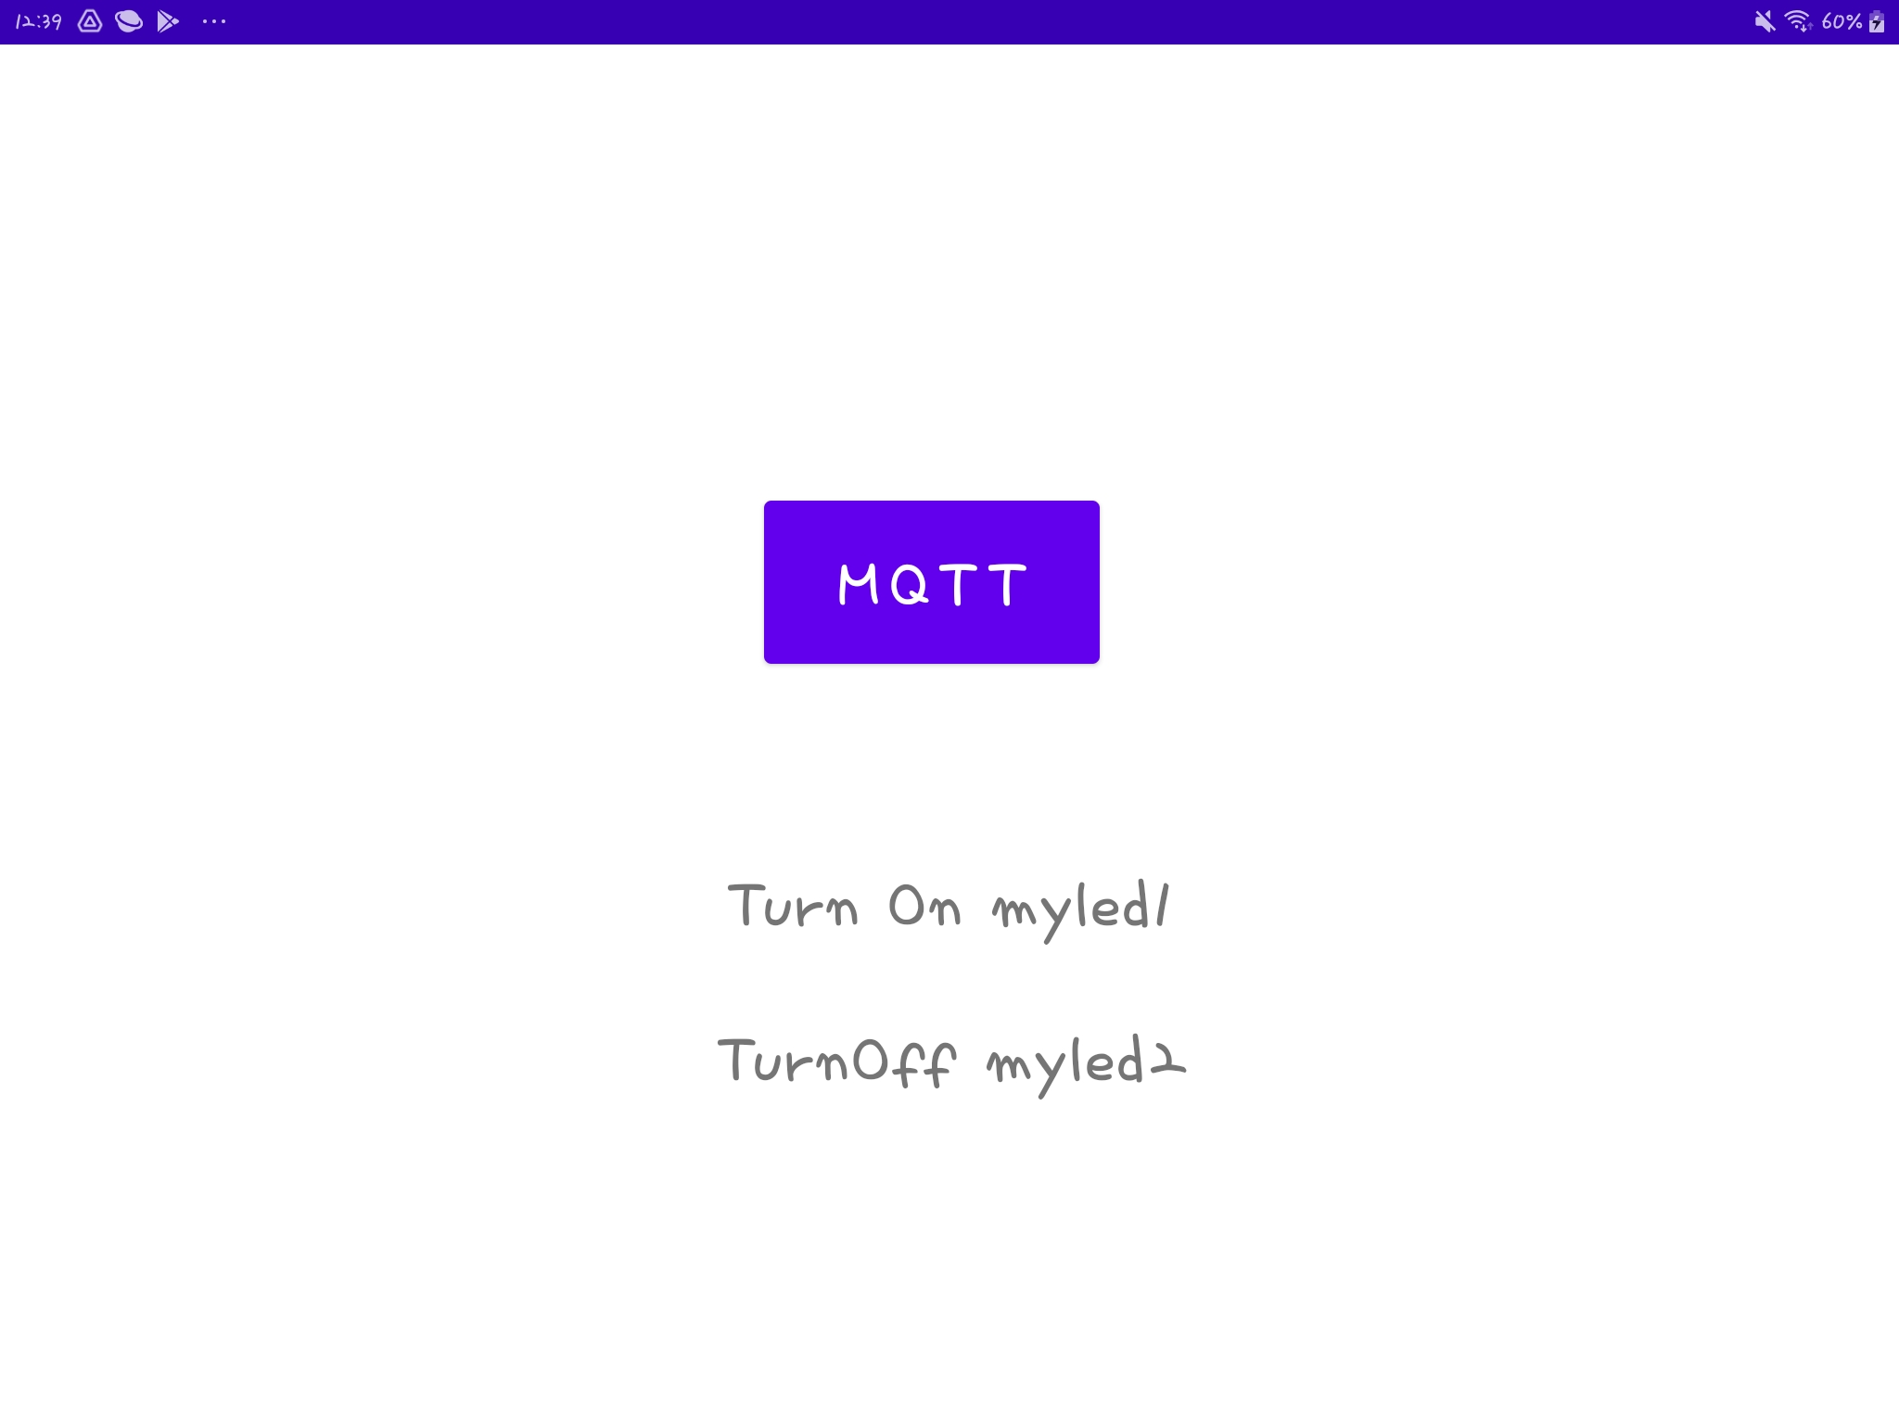
Android application - MQTT

Slide 14
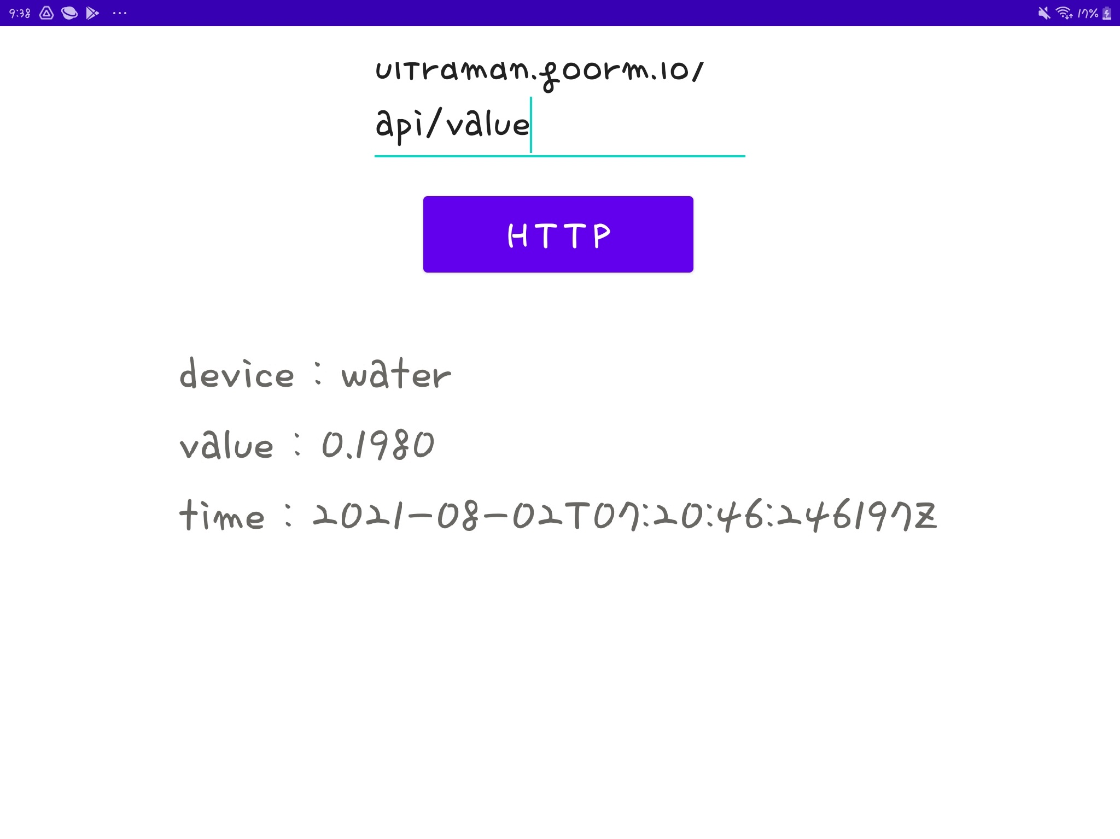
Android application - HTTP

Slide 15
Android application - Unresolved problem
Error
Try to install the certificate from cmd

Slide 16
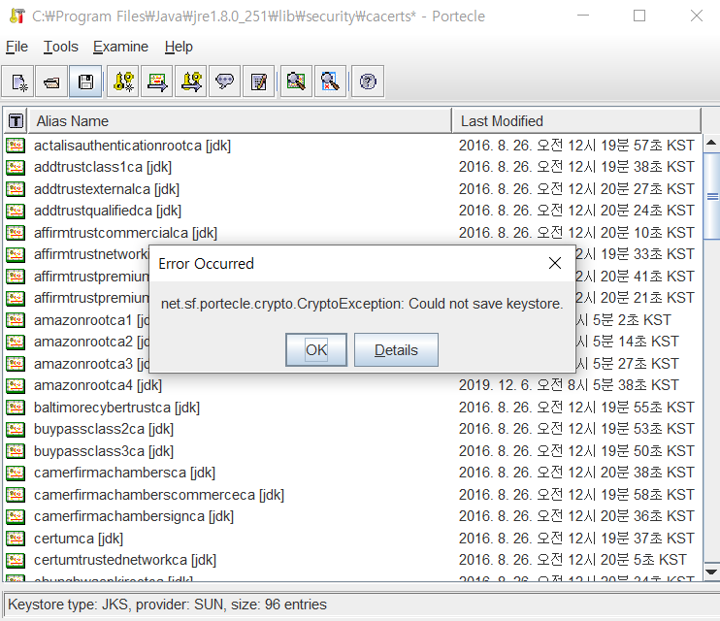
Android application - Unresolved problem
Try to install the certificate using 'portecle' program

Slide 17
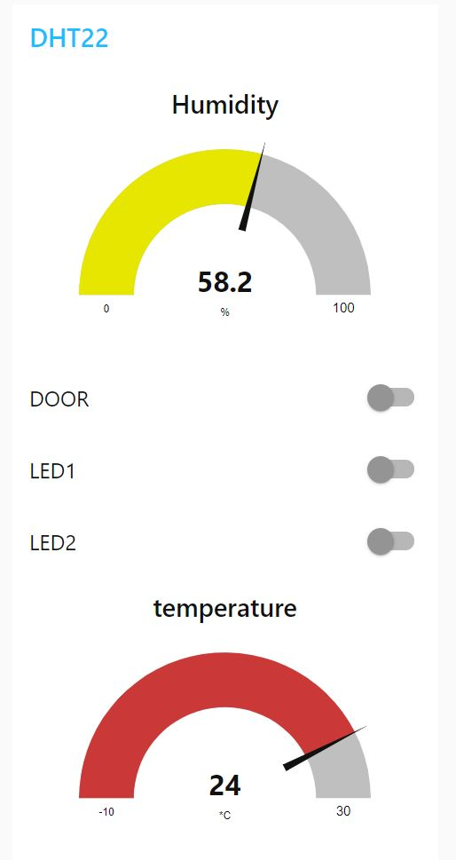
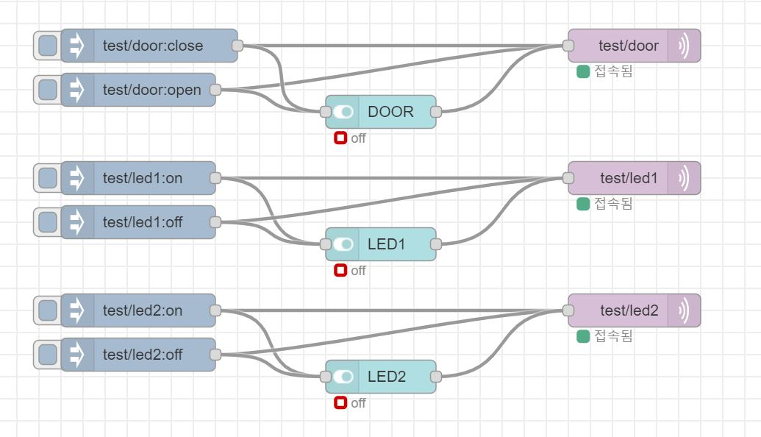
Build an IoT Platform from Scratch
Alternative
Node-RED flow
Dashboard in Node-RED

Slide 18
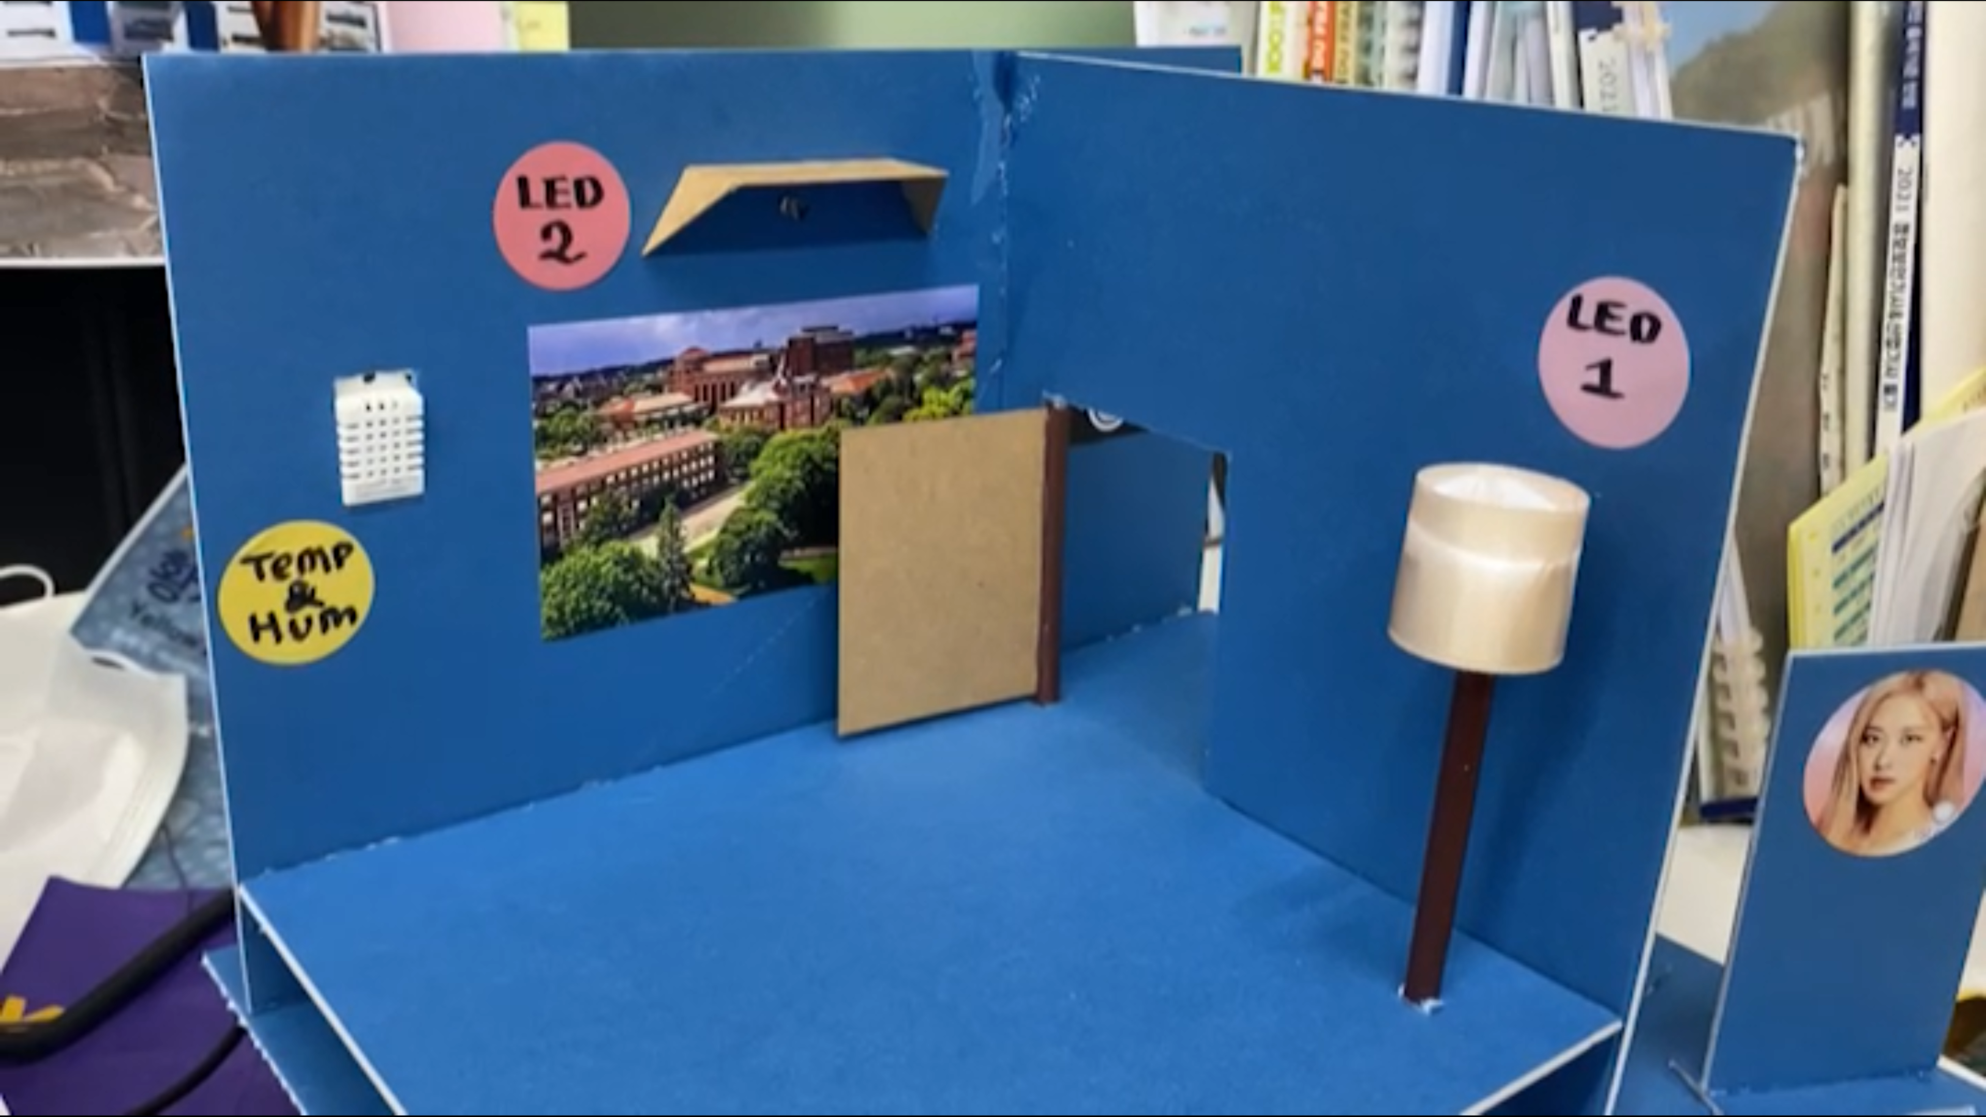
Build an IoT Platform from Scratch
Result of project

Slide 19
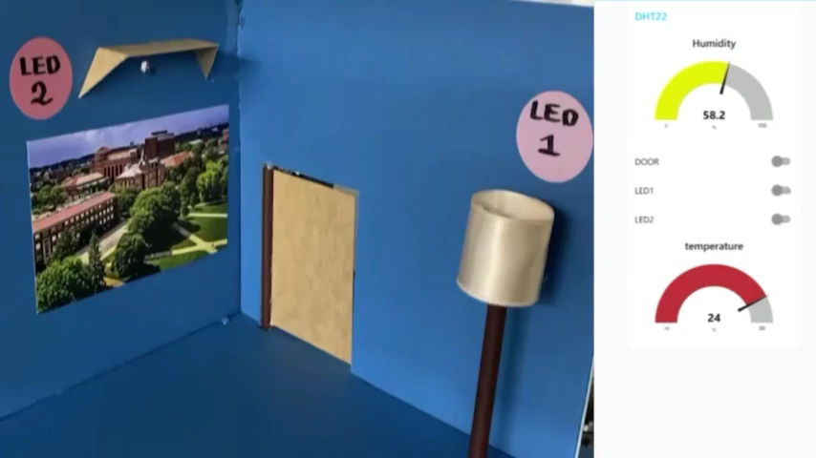
Build an IoT Platform from Scratch
LED System

Slide 20
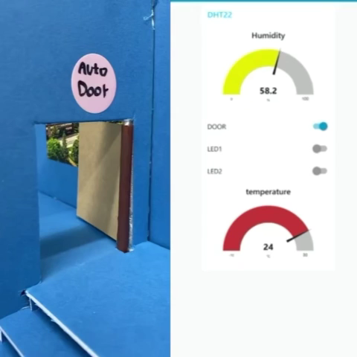
Build an IoT Platform from Scratch
Remote Door

Slide 21
Build an IoT Platform from Scratch
Improvement and development potential
Resolve problems found
Add more functions and devices

Slide 22
Thank you
Project 7
Build an IoT Platform from Scratch

